Slide 1

NATIONAL UNIVERSITY OF MODERN LANGUAGES
Faculty of Engineering and Computing
Department of Software Engineering

Slide 2

SOFTWARE DESIGN AND ARCHITECTURE
LECTURE NO. 8
Introduction to Software Engineering Design
Course Instructor: | Mr. Ahsan Arif
 | Lecturer Department of Software Engineering NUML Islamabad
Date: April 15, 2024
Software Engineering Design: Theory and Practice

Slide 3
LECTURE CONTENTS
  State Machine Diagram (Process View)
    Introduction
    Symbols used in State Machine diagram
    Meaning of symbols/notations
    Steps to draw a State Machine Diagram
    Creating a State chart Diagram for an Object
      Example – Object that controls a Heating, Ventilation and Air-Conditioning system (HVAC)
Date: April 15, 2024
Software Engineering Design: Theory and Practice

Slide 4
UML – STATE MACHINE DIAGRAM (PROCESS VIEW)
Introduction:
Dynamic Diagrams
  Activity Diagrams
    Describe the flow of work
    Parallel processing
  Sequence Diagrams
    Describe the sequence of messages passed between objects
  State Machine
    Describe the behavior of single objects
Date: April 15, 2024
Software Engineering Design: Theory and Practice
Notes:
Class diagrams model the static behavior of objects, i.e.
Attributes of objects
Operation of objects
Relationships between objects.

Slide 5
Introduction (Cont.)
State diagrams are closely related to activity diagrams.
The main difference between an activity diagram and a state machine diagram lies in their focus and representation.
Activity Diagrams | State Machine Diagrams
Activity diagrams primarily depict flow of functions without trigger mechanisms. | State machine diagrams represent how an object changes states due to internal or external events.
Activity diagrams are activity-centric and show activities in a process. | State machine diagrams are centered around objects with changing states.
Date: April 15, 2024
Software Engineering Design: Theory and Practice
Notes:
Class diagrams model the static behavior of objects, i.e.
Attributes of objects
Operation of objects
Relationships between objects.

Slide 6
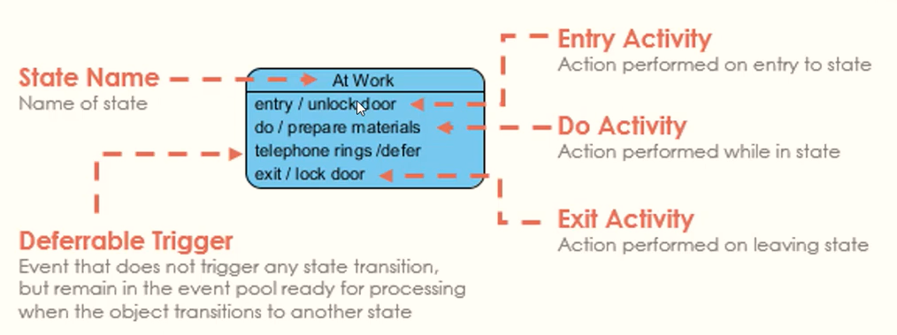
UML state diagrams and modeling:
A State chart diagram describes:
  Different states of a component in a system (The states are specific to a component/object of a system)
  States are controlled by external or internal events.
Date: April 15, 2024
Software Engineering Design: Theory and Practice
Notes:
Deferrable Triggers in UML state diagrams refer to triggers that are candidates to be retained by the state machine if they do not lead to any transitions out of the state. These triggers can be deferred, meaning they are not consumed immediately, but can be used later to initiate a transition. This mechanism allows for the postponement of certain trigger events until the appropriate conditions are met within the state machine.

Slide 7

UML state diagrams and modeling (Cont.)
For example, a telephone has different states.
It may be ‘hung up’, ‘dialing’, ‘engaged in a call’, or ‘disconnected’.
  These are states of the phone and we can use a state diagram to link the states together and determine the legal flows through the system.
While an item is in a particular state, work may or may not be going on, i.e. when you hang up a phone, there is no activity in the phone. When making a call, there is a lot of activity on the phone.
States are therefore useful logical views of an entity.
Date: April 15, 2024
Software Engineering Design: Theory and Practice
Notes:
Class diagrams model the static behavior of objects, i.e.
Attributes of objects
Operation of objects
Relationships between objects.

Slide 8
UML state diagrams and modeling (Cont.)
Purposes of State chart diagrams −
  It gives system behavior i.e. dynamic nature
  It helps to model the life time of a reactive system
  To describe different states of an object during its life time.
Click – Event
Normal state to play sound state
Activity – Playing music
Play Sound
Date: April 15, 2024
Software Engineering Design: Theory and Practice
Notes:
Class diagrams model the static behavior of objects, i.e.
Attributes of objects
Operation of objects
Relationships between objects.

Slide 9
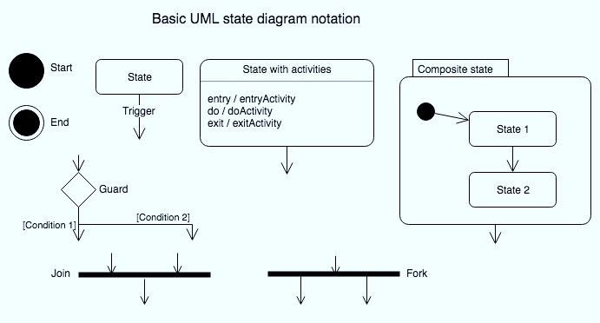
Symbols used in State Machine diagram:
Date: April 15, 2024
Software Engineering Design: Theory and Practice
Notes:
Class diagrams model the static behavior of objects, i.e.
Attributes of objects
Operation of objects
Relationships between objects.

Slide 10
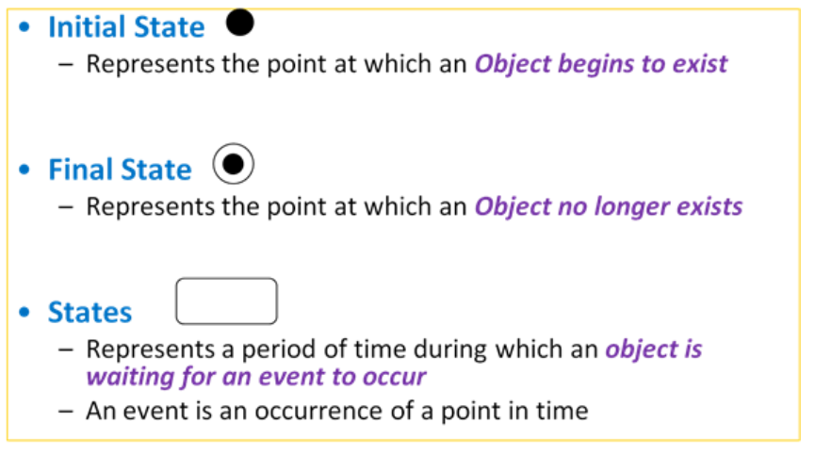
Meaning of symbols/notations:
Date: April 15, 2024
Software Engineering Design: Theory and Practice
Notes:
Class diagrams model the static behavior of objects, i.e.
Attributes of objects
Operation of objects
Relationships between objects.

Slide 11
Meaning of symbols/notations (Cont.)
Notation
Event
  Triggers a change in State
  Can be a Designated Condition that MUST be TRUE
  Used to label a Transition
Transitions
  Represents a response to an event
  May cause a change of state or is recursive within the same state
  May invoke operations or transmit events
  A transition links one state with another
  A transition can support an event/action block
Date: April 15, 2024
Software Engineering Design: Theory and Practice
Notes:
Class diagrams model the static behavior of objects, i.e.
Attributes of objects
Operation of objects
Relationships between objects.

Slide 12
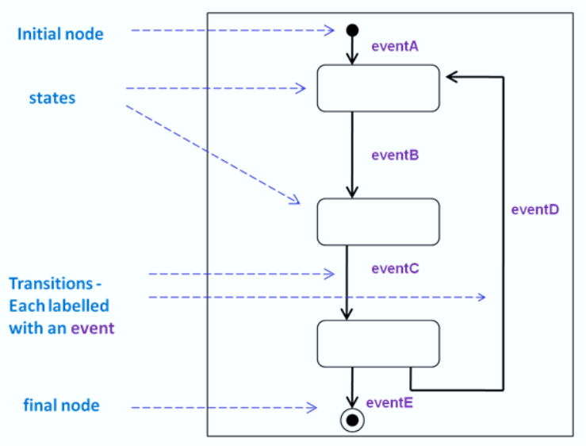
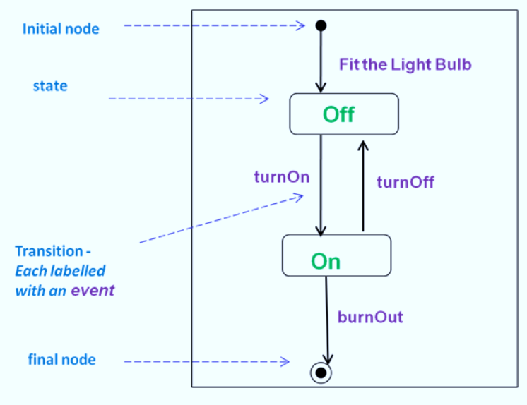
Example…
Start:
  Fit the Light Bulb -> ‘Off’ State
Turn Light Bulb On -> “On” State
Turn Light Bulb Off -> “Off” State
While in the “On” State ….
  …… Bulb Burns Out -> End
Date: April 15, 2024
Software Engineering Design: Theory and Practice
Notes:
Class diagrams model the static behavior of objects, i.e.
Attributes of objects
Operation of objects
Relationships between objects.

Slide 13
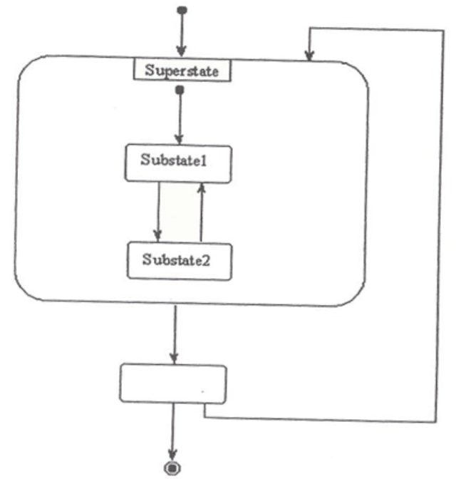
Meaning of symbols/notations (Cont.)
Composite State & Substates
  A composite state is a state that can contain other states, which are called substates.
    The substates themselves can be simple states or other composite states, creating a hierarchy of states. This allows for more complex state machines to be modeled.
Date: April 15, 2024
Software Engineering Design: Theory and Practice
Notes:
Class diagrams model the static behavior of objects, i.e.
Attributes of objects
Operation of objects
Relationships between objects.

Slide 14
Meaning of symbols/notations (Cont.)
Composite State & Substates
The diagram in next slide is a composite statechart diagram for a device, likely a mobile phone, that controls entering a PIN (Personal Identification Number) and turning the device on or off.
The outermost composite state is labeled “Phone”. Within it, there are two substates: “Ready” and “Check PIN”.
The phone initially starts in the “Check PIN” state. There are two events that can happen here:
  If a valid PIN is entered (PIN OK), the phone transitions to the “Ready” state.
  If an invalid PIN is entered (PIN Invalid), the phone stays in the “Check PIN” state.
From the “Ready” state, the phone can either:
  Enter the “Check PIN” state again if the event “Power Off” is triggered (pressing the power button?)
  Remain in the “Ready” state if no event occurs.
Date: April 15, 2024
Software Engineering Design: Theory and Practice
Notes:
Class diagrams model the static behavior of objects, i.e.
Attributes of objects
Operation of objects
Relationships between objects.

Slide 15
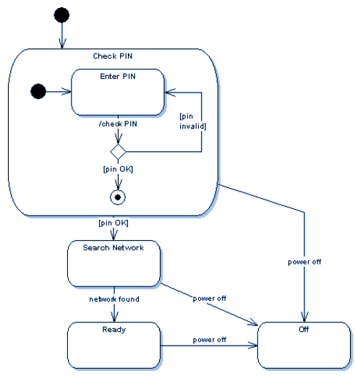
Meaning of symbols/notations (Cont.)
Date: April 15, 2024
Software Engineering Design: Theory and Practice
Notes:
Class diagrams model the static behavior of objects, i.e.
Attributes of objects
Operation of objects
Relationships between objects.

Slide 16
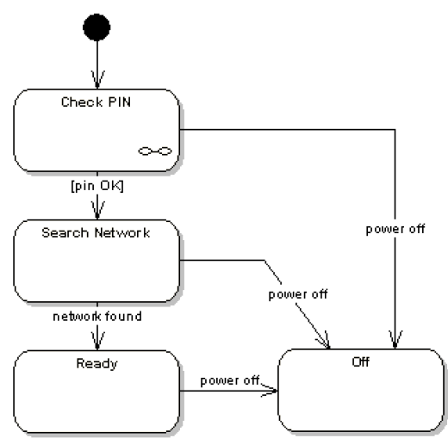
Meaning of symbols/notations (Cont.)
Same example, with an alternative notation…
The link symbol in the “Check Pin” state indicates that the details of the sub-machine associated with “Check Pin” are specified in an another state machine.
Date: April 15, 2024
Software Engineering Design: Theory and Practice
Notes:
Class diagrams model the static behavior of objects, i.e.
Attributes of objects
Operation of objects
Relationships between objects.

Slide 17
Meaning of symbols/notations (Cont.)
Concurrent Substates
If a composite state is active, only one of its substates is active at any point in time.
If you want to achieve concurrent states, a composite state can be divided into two or more regions, whereby one state of each region is always active at any point in time. This type of Concurrent Substate is also known as an Orthogonal State.
  Each region of an orthogonal state can have an initial state.
  A transition to the boundary of the orthogonal state then activates the initial states of all regions.
  Each region can also have a final state.
Date: April 15, 2024
Software Engineering Design: Theory and Practice
Notes:
Class diagrams model the static behavior of objects, i.e.
Attributes of objects
Operation of objects
Relationships between objects.

Slide 18
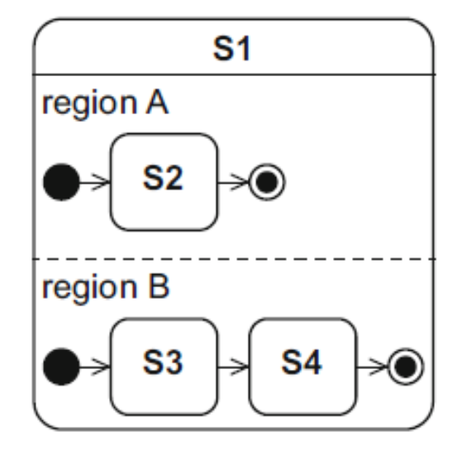
Meaning of symbols/notations (Cont.)
Date: April 15, 2024
Software Engineering Design: Theory and Practice
Notes:
Class diagrams model the static behavior of objects, i.e.
Attributes of objects
Operation of objects
Relationships between objects.

Slide 19
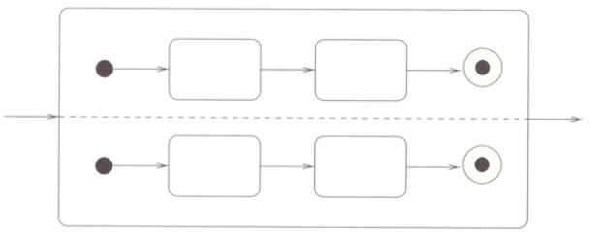
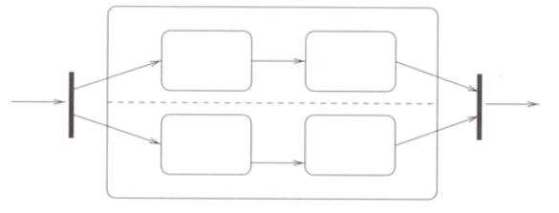
Meaning of symbols/notations (Cont.)
State with Internal Concurrency
Equivalent state with external synchronization
Date: April 15, 2024
Software Engineering Design: Theory and Practice
Notes:
Class diagrams model the static behavior of objects, i.e.
Attributes of objects
Operation of objects
Relationships between objects.

Slide 20
Steps to draw a State Machine Diagram:
Creating a State chart Diagram for an Object
  Possible/Suggested Steps in Creating a State chart Diagram for an Object:
  Draw the initial and final state for the object.
  Draw the stable states of the object.
  Specify the partial ordering of stable states over the lifetime of the object.
  Specify the events that trigger the transitions between the states of the object. Specify transition actions (if any).
  Specify the actions within a state (if any).
Date: April 15, 2024
Software Engineering Design: Theory and Practice
Notes:
Class diagrams model the static behavior of objects, i.e.
Attributes of objects
Operation of objects
Relationships between objects.

Slide 21

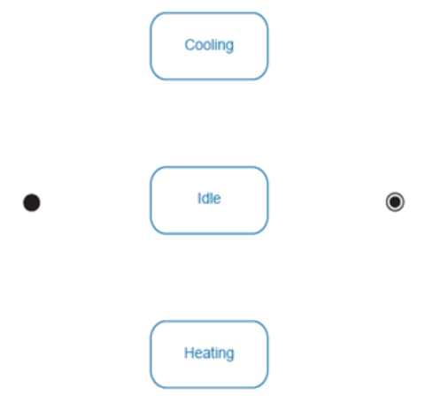
Steps to draw a State Machine Diagram (Cont.)
Start With the Initial and Final States
Determine Stable Object States
Date: April 15, 2024
Software Engineering Design: Theory and Practice
Notes:
The idle state in a UML state diagram typically represents a state where the system or object is not actively engaged in a particular task or operation. In the context of UML state diagrams, the idle state is a starting point or a state of inactivity before the system transitions to other states based on specific conditions or events.

Slide 22
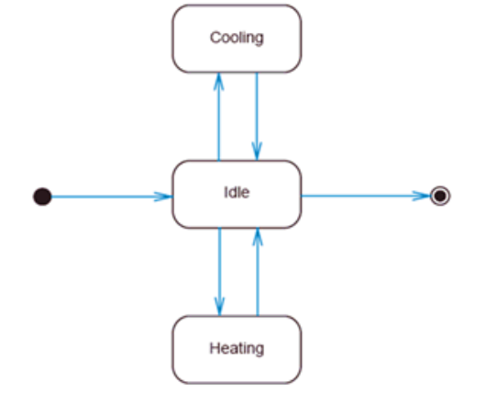
Steps to draw a State Machine Diagram (Cont.)
Specify the Partial Ordering of States
Date: April 15, 2024
Software Engineering Design: Theory and Practice
Notes:
Class diagrams model the static behavior of objects, i.e.
Attributes of objects
Operation of objects
Relationships between objects.

Slide 23
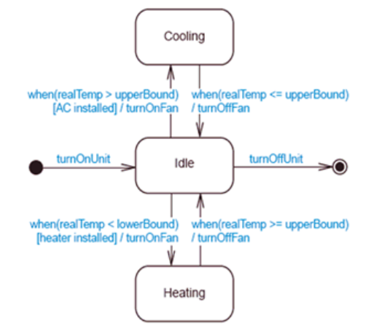
Steps to draw a State Machine Diagram (Cont.)
Specify the Transition Events and Actions
Date: April 15, 2024
Software Engineering Design: Theory and Practice
Notes:
Class diagrams model the static behavior of objects, i.e.
Attributes of objects
Operation of objects
Relationships between objects.

Slide 24
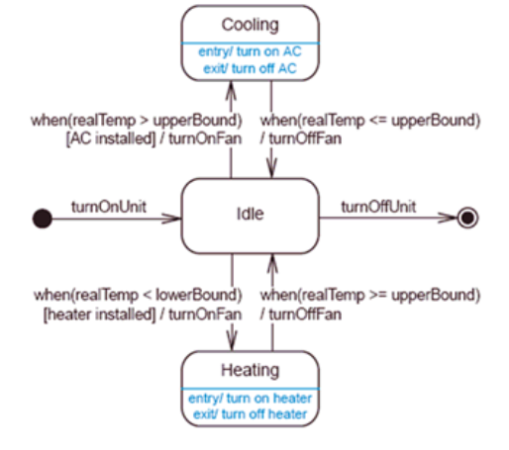
Steps to draw a State Machine Diagram (Cont.)
Specify the Actions Within a State
Date: April 15, 2024
Software Engineering Design: Theory and Practice
Notes:
Class diagrams model the static behavior of objects, i.e.
Attributes of objects
Operation of objects
Relationships between objects.

Slide 25
References
https://drive.google.com/file/d/1YA6fQwEhAzWwBxBq_wq7wIP7ysGQDdRI/view
https://www.youtube.com/watch?v=-PoMuzdUc6Y
https://www.youtube.com/watch?v=eNmlW7Hqgc8
Date: April 15, 2024
Software Engineering Design: Theory and Practice

Slide 26
Thank You...
Mr. Ahsan Arif
Lecturer (Dept. of Software Engineering)
ahsanarif.se42@gmail.com

